Slide 1
World Happiness Report
Linear & Multiple Regression Model
Shantanu Pandey – MSBA 2022-23

Slide 2
Index
Research Topic & specific research
Relation b/w dataset & background
Dataset Background
Dataset Variables Explained
Relationship between dataset & research question
How does World Happiness Report Work?
Mean & Standard Deviation values
Correlation & Covariance
Line Graph
Correlation Matrix Plot
Linear Regression
Multiple Linear Regression
Panel Data Regression Model
Inference
References

Slide 3
Research Topic & Specific Research Question
In the current era “Happiness” is a driving factor behind many of our actions throughout the life. Evidently it is highly important to understand the factors behind Happiness score and what causes an increase or decrease in a country’s overall happiness level.
The research paper is focused on World Happiness Report which is a publication of Sustainable Developments Solution Network powered by Gallup World Poll Data. It is generated every year with countries across the globe.
Through this, I intend to find causal relationships between the Happiness score and other socio-economic factors which affects this value. By doing so, I’ll be able to pin-point the highly corelated variables which effects Happiness Score.

Slide 4
Relation between dataset & research question
The variables mentioned in the previous slide are used by the “Sustainable Development Solutions Network” to generate a Happiness Score for a given country in a said year. To understand what factors should be focused upon to increase one’s Happiness Score we need to understand the degree of causality between these variables and Happiness Score.
And as the factors present in the dataset do affect the Happiness Score it is correlated with certain factors of our dataset.

Slide 5
Dataset Background
The World Happiness Report is a publication of the Sustainable Development Solutions Network, powered by the Gallup World Poll data.
Dataset contains 1232 entries
Contains 11 variables
Research is primarily centered around Happiness Score (Dependent Variable)
Contains independent variables such as Year, Country, GDP, Family Support, Life Expectancy, Government Corruption Score, Generosity and Dystopia Residual Value
Apart from Country(Factor) other variables are double type

Slide 6
Dataset variables explained
GDP per capita - is a measure of a country's economic output that accounts for its number of people.
Social support - it means having friends and other people, including family, to turn to in times of need or crisis to give you a broader focus and positive self-image. Social support enhances quality of life and provides a buffer against adverse life events.
Healthy life expectancy - the average number of years that a newborn can expect to live in "full health"—in other words, not hampered by disabling illnesses or injuries.
Freedom to make life choices - describes an individual's opportunity and autonomy to perform an action selected from at least two available options, unconstrained by external parties.
Generosity- the quality of being kind and generous.
Perceptions of corruption- The Corruption Perceptions Index (CPI) is an index published annually by Transparency International since 1995 which ranks countries "by their perceived levels of public sector corruption, as determined by expert assessments and opinion surveys.
Dystopia Residual Error - Each country is also compared against a hypothetical nation called Dystopia. Dystopia represents the lowest national averages for each key variable and is, along with residual error, used as a regression benchmark

Slide 7
How does World Happiness Report work?
Values for a given feature are based on answers to the main life evaluation question asked in the poll. This is called the Cantril ladder: it asks respondents to think of a ladder, with the best possible life for them being a 10 and the worst possible life being a 0. They are then asked to rate their own current lives on that 0 to 10 scale.
The variables used reflect what has been broadly found in the research literature to explain national-level differences in life evaluations
Shortcomings:
Variables such as unemployment or inequality are not present in the dataset because comparable international data are not yet available for all the countries in the report.
There might be two-way relationships between life evaluations and the chosen variables in several instances. E.g., Healthy people are overall happier but happy people are overall healthy.

Slide 8
Mean and Standard Deviation
Standard Deviation:
Happiness Score | 1.12
Freedom | 0.21
Economy_GDP_per_Capita | 0.1
Family | 0.01
HealthLifeExpectancy | 0.79
Trust_Government_Corruption | 0.29
Generosity | 0
Dystopia_Residual | 0.57
Mean
Happiness Score | 5.43
Freedom | 0.52
Economy_GDP_per_Capita | 3.05
Family | 0.99
HealthLifeExpectancy | 16.35
Trust_Government_Corruption | 0.29
Generosity | 0.14
Dystopia_Residual | 2.04

Slide 9
Correlation & Variance
Correlation
 | Happiness Score
Economy_GDP_per_Capita | 0.17
Family | 0.57
HealthLifeExpectancy | 0.09
Freedom | 0.41
Trust_Government_Corruption | 0.08
Generosity | 0.08
Dystopia_Residual | 0.46
Variance
 | Happiness Score
Economy_GDP_per_Capita | 0.68
Family | 0.20
HealthLifeExpectancy | 2.71
Freedom | 0.10
Trust_Government_Corruption | 0.02
Generosity | 0.01
Dystopia_Residual | 0.01

Slide 10
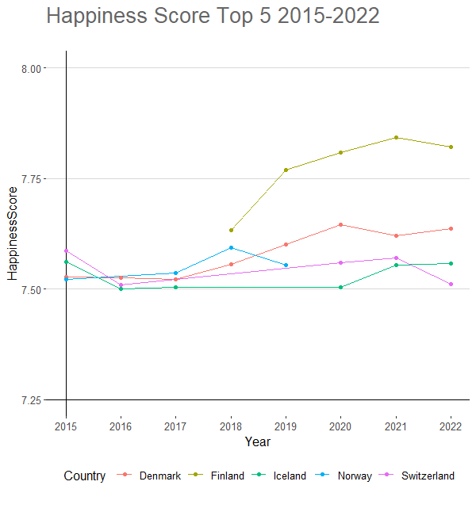
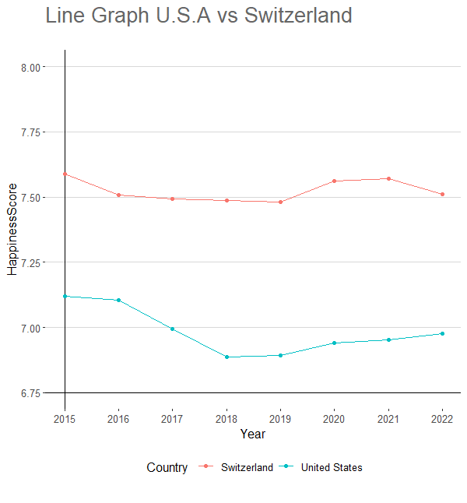
Line Graph

Slide 11
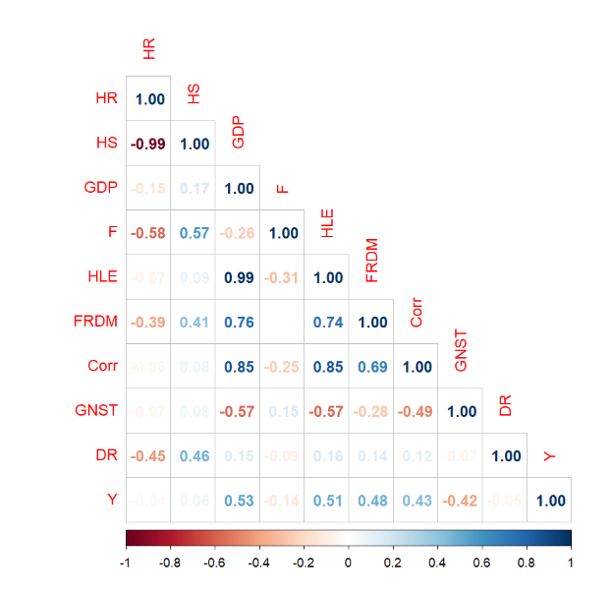
Correlation Matrix Plot
Acronyms:
HR :Happiness Rank
HS : Happiness Score
GDP : Economy GDP
F : Family Support
HLE : Healthy Life Expectancy
FRDM : Freedom
Corr : Government Corruption
GNST : Generosity
DR : Dystopia Residual

Slide 12
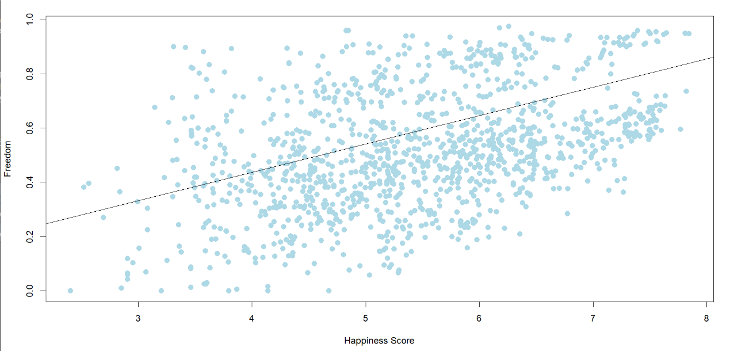
Linear Regression
Call:
lm(formula = HappinessScore ~ Freedom, data = WHR)
Residuals:
Min | 1Q | Median | 3Q | Max
-2.94875 | -0.74047 | -0.01167 | 0.77905 | 2.16621
Coefficients: |  | Estimate | Std. Error | t value | Pr(>|t|)
(Intercept) |  | 4.31475 | 0.07566 | 57.02 | <2e-16 | ***
Freedom |  | 2.16115 | 0.13545 | 15.96 | <2e-16 | ***
Signif. codes: 0 ‘***’ 0.001 ‘**’ 0.01 ‘*’ 0.05 ‘.’ 0.1 ‘ ’ 1
Residual standard error: 1.016 on 1228 degrees of freedom
Multiple R-squared: 0.8628, |  | Adjusted R-squared: 0.862
F-statistic: 1098 on 7 and 1222 DF, p-value: < 2.2e-16

Slide 13
Multiple Linear Regression(Time Independent)
Call:
lm(formula = HappinessScore ~ Freedom + WHR$Economy_GDP_per_Capita +
Family + WHR$HealthLifeExpectancy + WHR$TrustGovernment_Corruption +
Generosity + Dystopia_Residual, data = WHR)
Residuals:
Min | 1Q | Median | 3Q | Max
-2.06847 | -0.21263 | 0.01462 | 0.01462 | 1.17037
Coefficients: |  | Estimate | Std. Error | t value | Pr(>|t|)
(Intercept) |  | 0.119171 | 0.067032 | 1.778 | 0.0757 | .
Freedom |  | 1.522305 | 0.094803 | 16.057 | < 2e-16 | ***
Economy_GDP_per_Capita |  | 0.928023 | 0.027602 | 33.622 | < 2e-16 | ***
Family |  | 1.643861 | 0.045444 | 36.173 | < 2e-16 | ***
HealthLifeExpectancy |  | -0.11652 | 0.003632 | -32.08 | < 2e-16 | ***
Trust_Government_Corruption |  | -0.40563 | 0.081231 | -4.993 | 6.79E-07 | ***
Generosity |  | 1.220643 | 0.099326 | 12.289 | < 2e-16 | ***
Dystopia_Residual |  | 0.942014 | 0.020946 | 44.974 | < 2e-16 | ***
---
Signif. codes: 0 ‘***’ 0.001 ‘**’ 0.01 ‘*’ 0.05 ‘.’ 0.1 ‘ ’ 1
Residual standard error: 0.4143 on 1222 degrees of freedom
Multiple R-squared: 0.8628, |  | Adjusted R-squared: 0.862
F-statistic: 1098 on 7 and 1222 DF, p-value: < 2.2e-16

Slide 14
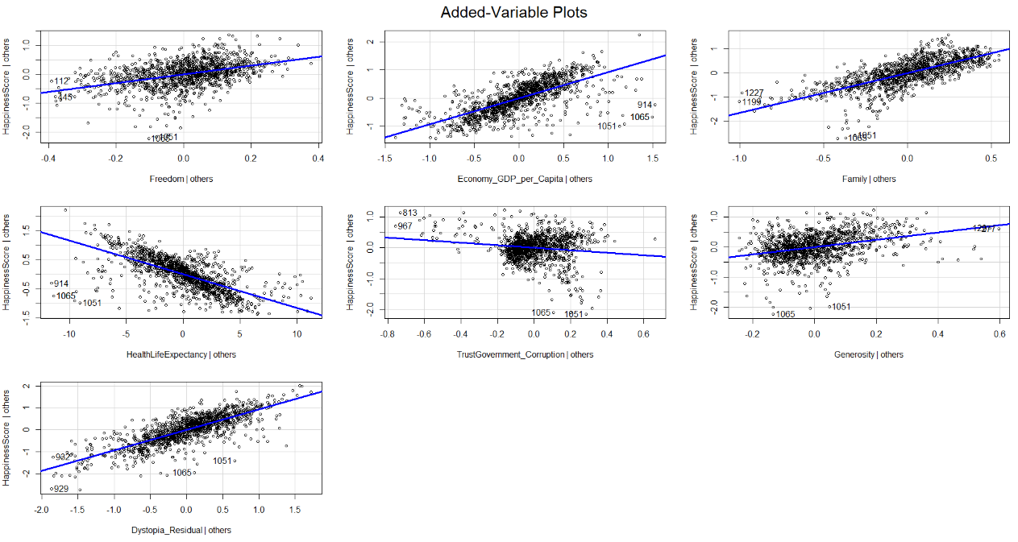
Multiple Regression Model Plot

Slide 15
Multiple Regression Model(Fixed Effect)
Call:
lm(formula = HappinessScore ~ Economy_GDP_per_Capita + Family +
HealthLifeExpectancy + Freedom + TrustGovernment_Corruption +
Year - 1, data = WHR_1_Dummy)
Residuals:
Min | 1Q | Median | 3Q | Max
-0.079836 | -0.008876 | 0.005244 | 0.020031 | 0.052645
Coefficients: |  | Estimate | Std. Error | t value | Pr(>|t|)
Family | 1.56 | 0.07 | 21.118 | '< 2e-16' | ***
GDP | 0.88 | 0.04 | 19.527 | '< 2e-16' | ***
Freedom | 1.79 | 0.15 | 11.583 | '< 2e-16' | ***
HealthLifeExpectancy | -0.11 | 0.01 | -18.183 | '< 2e-16' | ***
Corruption | -0.54 | 0.13 | -4.109 | 4.23E-05 | ***
Generosity | 1.23 | 0.16 | 7.607 | 5.59E-14 | ***
Year | 0.00 | 0.00 | 24.008 | '< 2e-16' | ***
Signif. codes: 0 ‘***’ 0.001 ‘**’ 0.01 ‘*’ 0.05 ‘.’ 0.1 ‘ ’ 1
Residual standard error: 0.6752 on 1223 degrees of freedom
Multiple R-squared: 0.9852, |  | Adjusted R-squared: 0.9852
F-statistic: 1.167e+04 on 7 and 1223 DF, p-value: < 2.2e-16

Slide 16
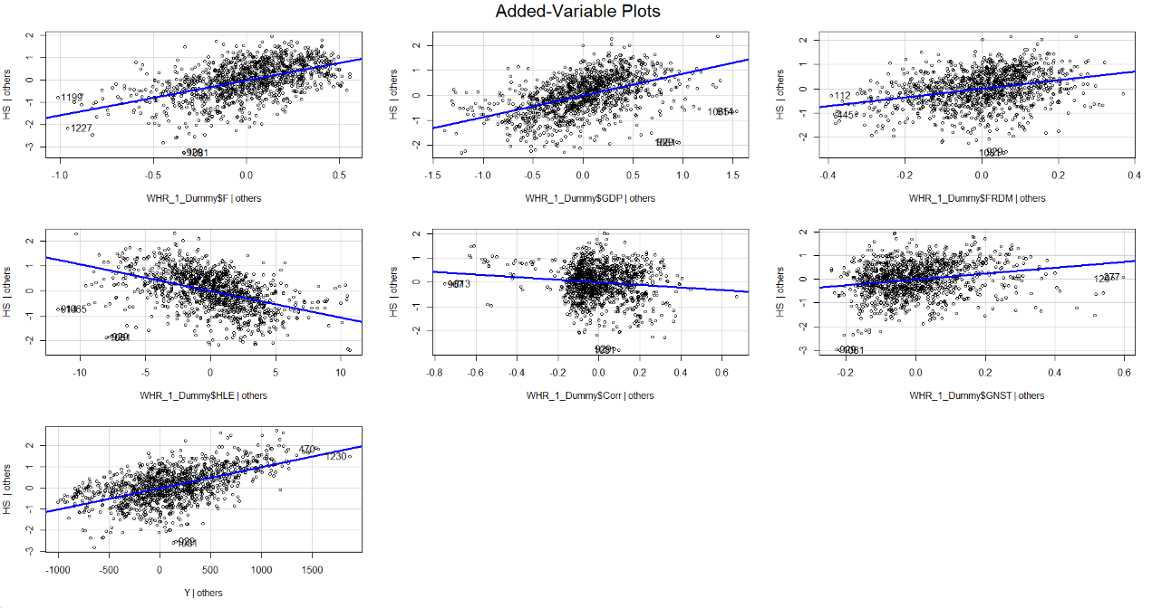
Multiple Regression Plot(Dummy : Year)

Slide 17
Panel Data Regression Model
Call:
plm(formula = HappinessScore ~ Economy_GDP_per_Capita + WHR_2$Family +
WHR_2$HealthLifeExpectancy + WHR_2$Freedom + WHR_2$TrustGovernment_Corruption +
WHR_2$Generosity, data = WHR_2, effect = "twoways", model = "within",index = c("Year"))
Balanced Panel: n = 8, T = 2, N = 16
Coefficients: |  | Estimate | Std. Error | t value | Pr(>|t|)
Economy_GDP_per_Capita |  | 2.06908 | 0.65787 | 3.1451 | 0.19598
Family |  | 13.14296 | 2.55918 | 5.1356 | 0.12243
HealthLifeExpectancy |  | 0.95194 | 0.14278 | 6.6670 | 0.09478
Freedom |  | -10.20724 | 2.58321 | -3.9514 | 0.15780
Trust_Government_Corruption |  | 8.21103 | 1.26598 | 6.4859 | 0.09739
Generosity |  | 8.89932 | 1.35273 | 6.5788 | 0.09603 | .
Total Sum of squares: 0.021893
Residual sum of squares: 7.82e-05
R-squared: 0.99643 |  | Adjusted R-squared: 0.94642
F-statistic: 46.4941 on 6 and 1 DF, p-value:0.11179
Residuals:
1 | 2 | 3 | 4 | 5 | 6 | 7 | 8 | 9
-3.1844e-03 | 3.1844e-03 | 2.4988e-03 | -2.4988-03 | -5.2476e-04 | 5.2476e-04 | -6.7290e-04 | 6.7290e-04 | 4.1300-03
10 | 11 | 12 | 13 | 14 | 15 | 16
-4.1300e-03 | -1.1320e04 | 1.1320e-04 | 8.2579e-05 | -8.2579e-05 | -2.2160-03 | 2.2160e-03

Slide 18
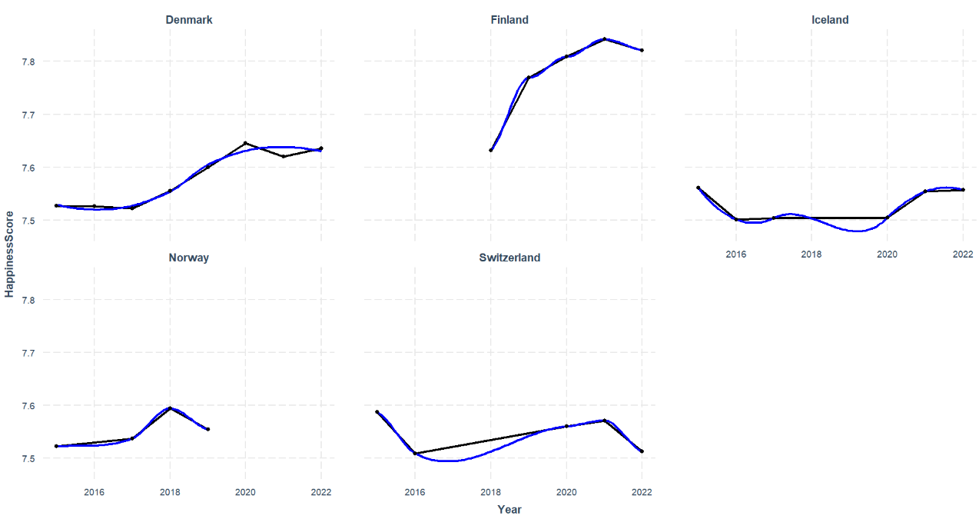
Panel Plot(Happiness Score>7.5)

Slide 19
Inference
The change in time fixed variables year on year will affect the happiness score for every country for that particular year. This proves causal inference.
I believe that the first assumption fails as there can be other factors apart from the one’s mentioned in the previous slides which effect the Happiness Score such as Availability of Food or basic health-care.

Slide 20
References
https-//www.kaggle.com/code/avnika22/world-happiness-report-eda-clustering/notebook
https-//worldhappiness.report

Slide 21
Thank You!

